Slide 1
Digital Diagnosis System: A Case Study for Brain Tumor
Submitted By:
Nazmus Shadat Shohan
Roll:160111
Dept of CSE,JUST
Supervised To:
Mustain Billah
Assistant Professor
Dept of CSE,JUST

Slide 2

Problem
We love healthy life , but sometimes life betray with us .

Slide 3
Why Brain Tumor ??
An estimated 16,616 people will die from malignant brain tumors (brain cancer) in 2016 !!!!!
Brain and other nervous system cancer is the 10th leading cause of death for men and women
If you are diagnosed, don't fear—more than 700,000 Americans are currently living with a brain tumor
Source: https://www.cancer.net/cancer-types/brain-tumor/statistics, access date: 5/3/2021

Slide 4
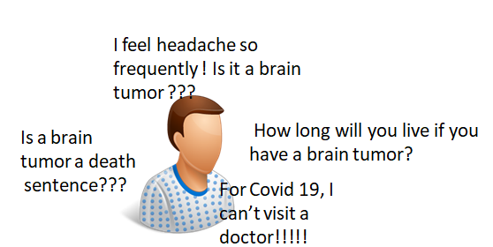
Why We Need Digital Diagnosis?

Slide 5

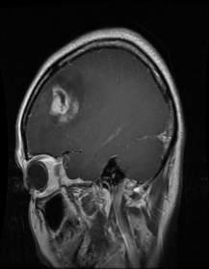
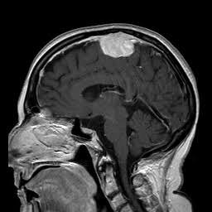
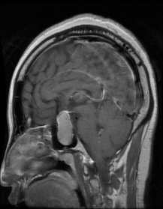
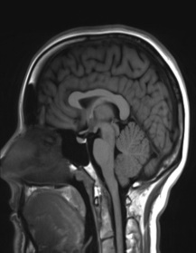
System Model
Initial Symptoms
Score Calculate
Matched with brain tumor
1)Glioma
2)Meningioma
3)Pituitary
4)No Tumor
Other questions
Yes
Diagnose final report
Classify Tumor Type
Input MRI
Suggest nearby doctors/hospitals
Collect patient location
Fig 1: System Model of the Proposed Diagnosis System

Slide 6
Literature Review:
Model: S. Salma et al.[5]
Prons: High number of features are calculated to detect tumors.
Cons: Only detect if the tumors are present or not, but can not classify tumors.
Model : D Stalin et al.[7]
Prons: Classified tumors into 6 different categories.
Cons: Number of dataset is very small.
Model :Hossam et al.[7]
Prons: Well established CNN model first using ‘Data Augmentation’ technique.
Cons: Only classifying tumors but can’t detect non-tumors.
Model :S.Deepak et al[8]
Prons: Extensive experiments are performed that comes with a good result.
Cons: Only classifying tumors but can’t detect non-tumors.

Slide 7
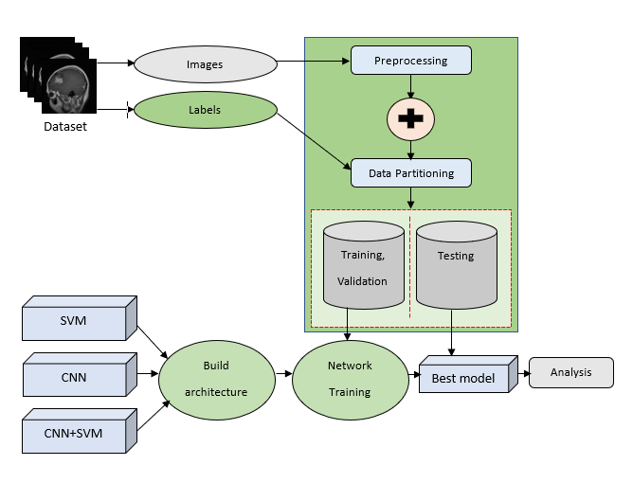
Architecture Diagram
Fig 2: Brain Tumor Classification Architecture

Slide 8
Dataset
This dataset contains a total 3264 number of images and has been divided into training and testing in a 80 to 20 percent ratio. We have worked on six algorithm.
Type | Classes | Number
Training | Glioma | 712
 | Meningioma | 755
 | No Tumor | 416
 | Pituitary | 728
Testing | Glioma | 214
 | Meningioma | 182
 | No Tumor | 84
 | Pituitary | 173
Algorithm
SVM
Random Forest
Logistic Regression
CNN
CNN-SVM
CNN-RF

Slide 9
Machine Learning Approach
Machine learning is an application of artificial intelligence (AI).
In this technique, features must be selected manually.
3 types of ML approaches are used in this portion.
They are Support Vector Machine, Random Forest, Logistic Regression.
The best results come from Support Vector Machine.

Slide 10
Support Vector Machine(SVM)
Support vector machine is a very popular ML algorithm.
It finds a hyperplane in an N-dimensional space.
The proposed method uses SVM with a kernel function ‘poly’.
The used features are GLCM-Textures, Gabor filter, First order derivatives.
Accuracy comes from this model is approximately 87.44%.

Slide 11
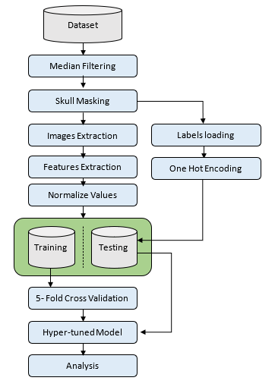
SVM Architecture
Fig 3: SVM Classification Architecture

Slide 12
Convolution Neural Network
CNN is one of the variants of neural network heavily used in the field of Computer Vision.
The hidden layers of a CNN typically consists of convolution layers, pooling layers, fully connected layers and normalization layers.
This method has a preprocessing step called ‘Data Augmentation’ .
The proposed model has a total 23 number of layers with a number of 4 consecutive convolution layers.
The accuracy comes from this model is approximately 92.96%.

Slide 13
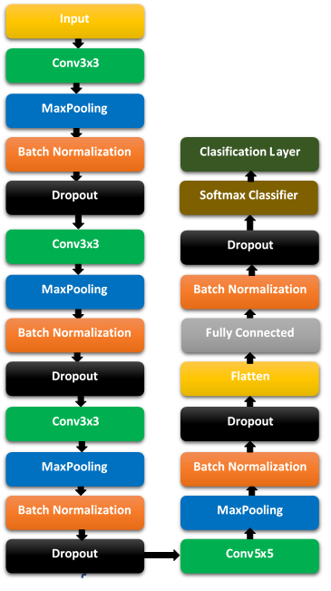
CNN Architecture
Fig 4: CNN Classification Architecture

Slide 14
CNN-SVM
This method is a hybridization of SVM and CNN.
The hybridization is also made of Random Forest and CNN.
CNN is used primarily to extract features automatically.
SVM is used to classify images based on the CNN features.
The accuracy comes from this model is approximately 97.24%.

Slide 15
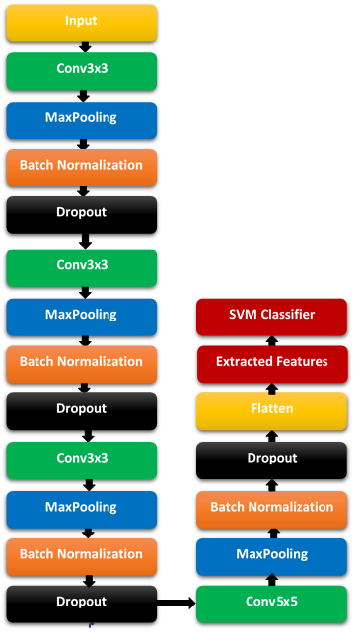
CNN-SVM Architecture
Fig 5: Brain Tumor Classification Architecture

Slide 16
Performance Analysis of ML Algorithms
Methods | Classes | Precision | Recall | F1-Score
SVM | Glioma | 0.88 | 0.85 | 0.87
 | Meningioma | 0.81 | 0.86 | 0.83
 | No Tumor | 0.87 | 0.77 | 0.82
 | Pituitary | 0.94 | 0.97 | 0.95
Random Forest | Glioma | 0.83 | 0.71 | 0.77
Forest | Meningioma | 0.70 | 0.79 | 0.74
 | No Tumor | 0.85 | 0.76 | 0.81
 | Pituitary | 0.86 | 0.93 | 0.89
Logistic Regression | Glioma | 0.82 | 0.66 | 0.73
Regression | Meningioma | 0.61 | 0.69 | 0.65
 | No Tumor | 0.74 | 0.68 | 0.71
 | Pituitary | 0.77 | 0.88 | 0.82

Slide 17
Performance Analysis of CNN
Methods | Classes | Precision | Recall | F1-Score
CNN | Glioma | 0.93 | 0.92 | 0.92
 | Meningioma | 0.94 | 0.91 | 0.92
 | No Tumor | 0.90 | 0.94 | 0.92
 | Pituitary | 0.93 | 0.97 | 0.95

Slide 18
Performance Analysis of Hybrid Methods
Methods | Classes | Precision | Recall | F1-Score
CNN-SVM | Glioma | 0.99 | 0.95 | 0.97
 | Meningioma | 0.94 | 0.99 | 0.97
 | No Tumor | 0.95 | 0.98 | 0.96
 | Pituitary | 1.00 | 0.98 | 0.99
CNN- Random Forest | Glioma | 0.95 | 0.86 | 0.91
Random | Meningioma | 0.86 | 0.92 | 0.89
Forest | No Tumor | 0.92 | 0.92 | 0.92
 | Pituitary | 0.94 | 0.98 | 0.96

Slide 19
Accuracy Comparison of different Algorithms

Slide 20
Comparison with Existing Models
Model | Accuracy | Classification Type | Method
P Satish et al.[1] | 89.52% | Multi 3 | RBNN
Wadhah et al.[2] | 90.27% | Multi 3 | SVM
Kaplan et al.[3] | 95.56% | Multi 3 | KNN
Rajini et al.[4] | 95% | Multi 3 | CNN
S.Salma et al.[5] | 95% | Binary 2 | RNN
D.Stalin et al.[6] | 93.75% | Binary 2 | SVM
Hossam et al.[7] | 96.13% | Multi 3 | CNN
S.Deepak et al.[8] | 95.82% | Multi 3 | CNN-SVM
Zarin et al.[9] | 97.1% | Multi 3 | CNN-SVM
Proposed Structure | 97.24% | Multi 4 | CNN-SVM

Slide 21
What’s Different?
Previous models only works with either detection or a classification of tumors.
This work provides a classification for both tumors and non-tumor part.
This work also provides a multiple comparison of different models.
Identify difference between machine and deep learning models for computer vision thorough this work.

Slide 22
Conclusion
Multiple machine and deep learning models are created in this work.
They are used to classify tumors into 4 different categories including a classification of non-tumor type.
A comparison between SVM,CNN and CNN-SVM is proposed.
The best method approximately get an accuracy of 97.3% which beat the previous work regarding with this technology.

Slide 23
Questions?

Slide 24
References
1. Sathish, P., Elango, N.M. Gaussian hybrid fuzzy clustering and radial basis neural network for automatic brain tumor classification in MRI images. Evol. Intel. (2020).https://doi.org/10.1007/s12065-020-00433-5
2. Ayadi, W., Charfi, I., Elhamzi, W. et al. Brain tumor classification based on hybrid approach. Vis Comput (2020). https://doi.org/10.1007/s00371-020-02005-1
3. Kaplan Kaplan, Yılmaz Kaya, Melih Kuncan, H. Metin Ertunç,Brain tumor classification using modified local binary patterns (LBP) feature extraction methods,Medical Hypotheses,Volume 139,2020,109696,ISSN 0306-9877,https://doi.org/10.1016/j.mehy.2020.109696.
4. Rajini N, H. (2017). Automatic classification of MR brain tumor images using KNN, ANN, SVM and CNN. International Research Journal of Engineering, IT & Scientific Research, 3(1), 36-44. https://doi.org/10.21744/irjeis.v3n1.895.
5. Begum, S.S., Lakshmi, D.R. Combining optimal wavelet statistical texture and recurrent neural network for tumour detection and classification over MRI. Multimed Tools Appl 79, 14009–14030 (2020). https://doi.or.g/10.1007/s11042-020-08643-w.

Slide 25
References
6.https://scholar.google.com/scholar?hl=en&as_sdt=0%2C5&as_ylo=2020&q=Classification+of+Brain+Tumor+Type+and+Grade+Using+MRI+Texture+and+Shape+in+a+Machine+Learning+Scheme&btnG=
7. H. H. Sultan, N. M. Salem and W. Al-Atabany, "Multi-Classification of Brain Tumor Images Using Deep Neural Network," in IEEE Access, vol. 7, pp. 69215-69225, 2019, doi: 10.1109/ACCESS.2019.2919122.
8. Deepak, S., Ameer, P.M. Automated Categorization of Brain Tumor from MRI Using CNN features and SVM. J Ambient Intell Human Comput (2020). https://doi.org/10.1007/s12652-020-02568-w.
9. Z. A. Sejuti and M. S. Islam, "An Efficient Method to Classify Brain Tumor using CNN and SVM," 2021 2nd International Conference on Robotics, Electrical and Signal Processing Techniques (ICREST), DHAKA, Bangladesh, 2021, pp. 644-648, doi: 10.1109/ICREST51555.2021.9331060.
10. Stalin David and Arun, “Classification of Brain Tumor Type and Grade Using MRI Texture and Shape in a Machine Learning Scheme’ Volume, 1, Issue 3, 2020, Pages: 57-63,ISSN: 2523-6164.

Slide 26
Thank You

